Slide 1
The Foundations: Logic and Proofs
Chapter 2, Part III: Proofs

Slide 2
Rules of Inference

Slide 3
Section Summary
Valid Arguments
Inference Rules for Propositional Logic
Using Rules of Inference to Build Arguments
Rules of Inference for Quantified Statements
Building Arguments for Quantified Statements

Slide 4
Arguments in Propositional Logic
A argument in propositional logic is a sequence of propositions. All but the final proposition are called premises. The last statement is the conclusion.
The argument is valid if the premises imply the conclusion. An argument form is an argument that is valid no matter what propositions are substituted into its propositional variables.
If the premises are p₁ ,p₂, …,p_{n} and the conclusion is q then
(p₁ ∧ p₂ ∧ … ∧ p_{n} ) → q is a tautology.
Inference rules are all argument simple argument forms that will be used to construct more complex argument forms.

Slide 5
Revisiting the Socrates Example
We have the two premises:
“All men are mortal.”
If someone is a man, then that person is mortal.
“Socrates is a man.”
This tells us that Socrates belongs to the group men.
And the conclusion:
“Socrates is mortal.”
How do we get the conclusion from the premises?

Slide 6
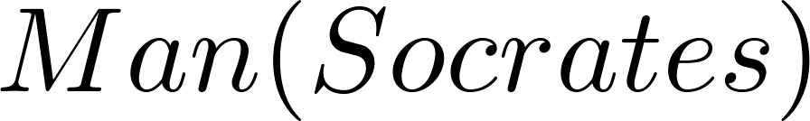
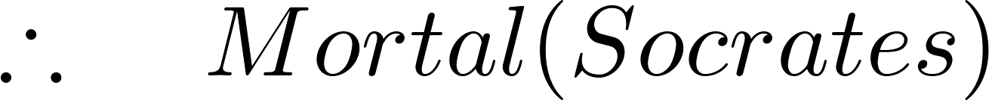
The Argument
We can express the premises (above the line) and the conclusion (below the line) in predicate logic as an argument:
We will see shortly that this is a valid argument.

Slide 7
Argument – Example
Consider the following argument (sequence of propositions)
“If you have a current password, then you can log onto the network.”
“You have a current password.”
Therefore, “You can log onto the network.”
To determine if it is a valid argument?

Slide 8
Argument Form
Using p to represent “You have a current password” and q to represent “You can log onto the network.” Then, the argument has the form
p → q
p
∴ q
Symbol ∴ denotes “therefore.”

Slide 9
Validity of Argument
An argument is valid if the truth of all its premises implies that the conclusion is true.
An argument is valid if and only if it is impossible for all the premises to be true and the conclusion to be false

Slide 10
Validity of Argument
P | Q | P → Q
T | T | T
T | F | F
F | T | T
F | F | T

Slide 11
Valid Arguments
We will show how to construct valid arguments in two stages; first for propositional logic and then for predicate logic. The rules of inference are the essential building block in the construction of valid arguments.
Propositional Logic
Inference Rules
Predicate Logic
Inference rules for propositional logic plus additional inference rules to handle variables and quantifiers.

Slide 12
Rules of Inference for Propositional Logic
A truth table can be used to show that an argument form is valid by showing that whenever the premises are true, the conclusion must also be true.
However, it’s a tedious approach.
If an argument form involves 10 different propositional variables, to use a truth table to show this argument form is valid requires 2¹⁰ = 1024 different rows.

Slide 13
Rules of Inference
Rules of inference – simple argument forms
These rules of inference can be used as building blocks to construct more complicated valid argument forms

Slide 14
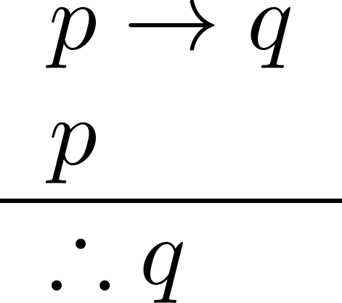
Rules of Inference for Propositional Logic: Modus Ponens
If P implies Q and P is true then Q must be true
Corresponding Tautology:
(p ∧ (p →q)) → q
Example:
Let p be “It is snowing.”
Let q be “I will study discrete math.”
“If it is snowing, then I will study discrete math.”
“It is snowing.”
“Therefore , I will study discrete math.”

Slide 15
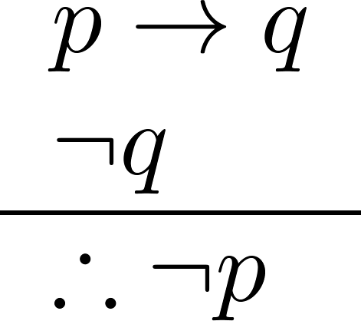
Modus Tollens
If P, then Q
Not Q
Therefore, not P
Corresponding Tautology:
(¬q∧(p →q))→¬p
Example:
Let p be “it is snowing.”
Let q be “I will study discrete math.”
“If it is snowing, then I will study discrete math.”
“I will not study discrete math.”
“Therefore , it is not snowing.”

Slide 16
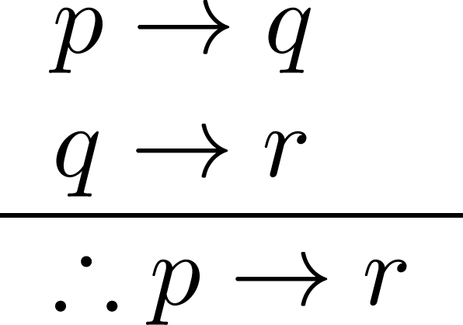
Hypothetical Syllogism
If P, then Q
If Q, then R
Therefore, if P, then R
Corresponding Tautology:
((p →q) ∧ (q→r))→(p→ r)
Example:
Let p be “it snows.”
Let q be “I will study discrete math.”
Let r be “I will get an A.”
“If it snows, then I will study discrete math.”
“If I study discrete math, I will get an A.”
“Therefore , If it snows, I will get an A.”

Slide 17
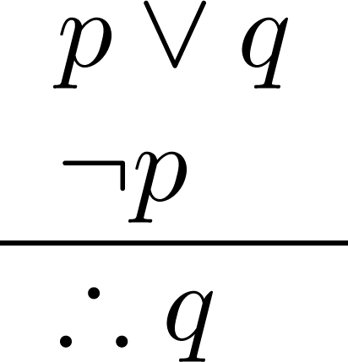
Disjunctive Syllogism
P OR Q
NOT P
Therefore, Q
Corresponding Tautology:
(¬p∧(p ∨q))→q
Example:
Let p be “I will study discrete math.”
Let q be “I will study English literature.”
“I will study discrete math or I will study English literature.”
“I will not study discrete math.”
“Therefore , I will study English literature.”

Slide 18
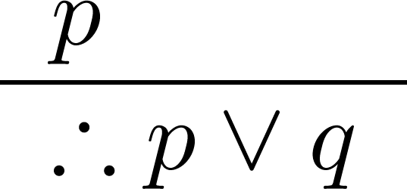
Addition
P
Therefore, P OR Q
Corresponding Tautology:
p →(p ∨q)
Example:
Let p be “I will study discrete math.”
Let q be “I will visit Las Vegas.”
“I will study discrete math.”
“Therefore, I will study discrete math or I will visit
Las Vegas.”

Slide 19

Simplification
P AND Q
Therefore, P
Corresponding Tautology:
(p∧q) →p
Example:
Let p be “I will study discrete math.”
Let q be “I will study English literature.”
“I will study discrete math and English literature”
“Therefore, I will study discrete math.”

Slide 20
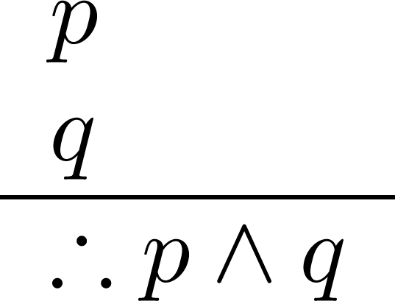
Conjunction
P
Q
Therefore, P AND Q
Corresponding Tautology:
((p) ∧ (q)) →(p ∧ q)
Example:
Let p be “I will study discrete math.”
Let q be “I will study English literature.”
“I will study discrete math.”
“I will study English literature.”
“Therefore, I will study discrete math and I will study English literature.”

Slide 21
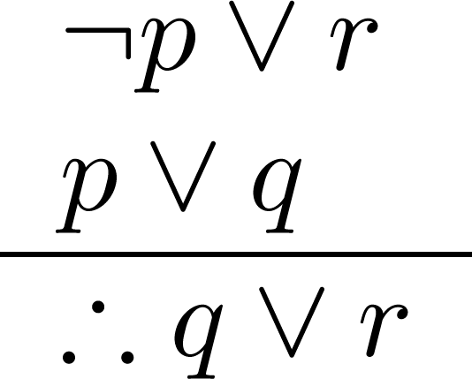
Resolution
Resolution plays an important role in AI and is used in Prolog.
P OR Q
NOT P OR R
Therefore, Q OR R
Corresponding Tautology:
((¬p ∨ r ) ∧ (p ∨ q)) →(q ∨ r)
Example:
Let p be “I will study discrete math.”
Let r be “I will study English literature.”
Let q be “I will study databases.”
“I will not study discrete math or I will study English literature.”
“I will study discrete math or I will study databases.”
“Therefore, I will study databases or I will study English literature.”

Slide 22
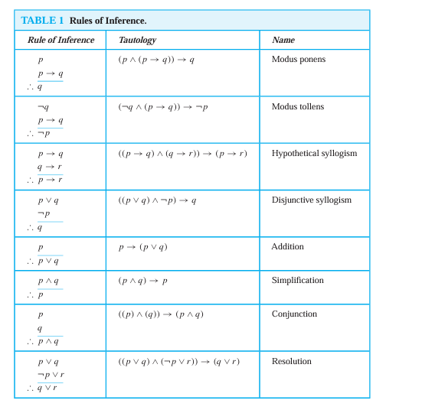
Rule of Inference Table:

Slide 23
Using the Rules of Inference to Build Valid Arguments
A valid argument is a sequence of statements. Each statement is either a premise or follows from previous statements by rules of inference. The last statement is called conclusion.
A valid argument takes the following form:
S₁
S₂
.
.
.
S_{n}
C

Slide 24
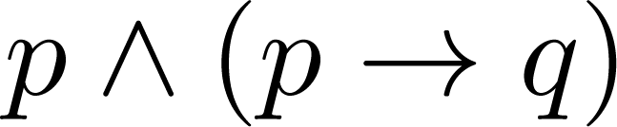
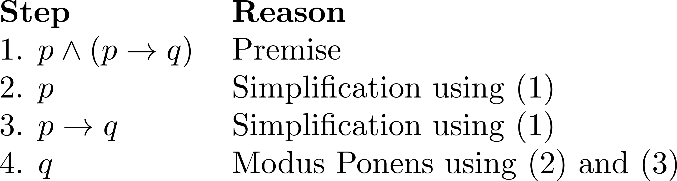
Valid Arguments
Example 1: From the single proposition
Show that q is a conclusion.
Solution:

Slide 25
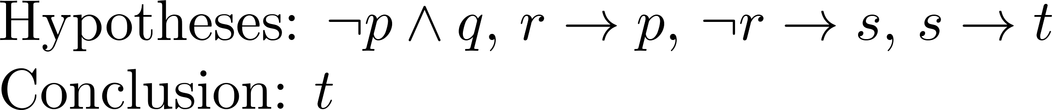
Valid Arguments
Example 2:
With these hypotheses:
“It is not sunny this afternoon and it is colder than yesterday.”
“We will go swimming only if it is sunny.”
“If we do not go swimming, then we will take a canoe trip.”
“If we take a canoe trip, then we will be home by sunset.”
Using the inference rules, construct a valid argument for the conclusion:
“We will be home by sunset.”
Solution:
Choose propositional variables:
p : “It is sunny this afternoon.” r : “We will go swimming.” t : “We will be home by sunset.”
q : “It is colder than yesterday.” s : “We will take a canoe trip.”
Translation into propositional logic:
Continued on next slide →

Slide 26
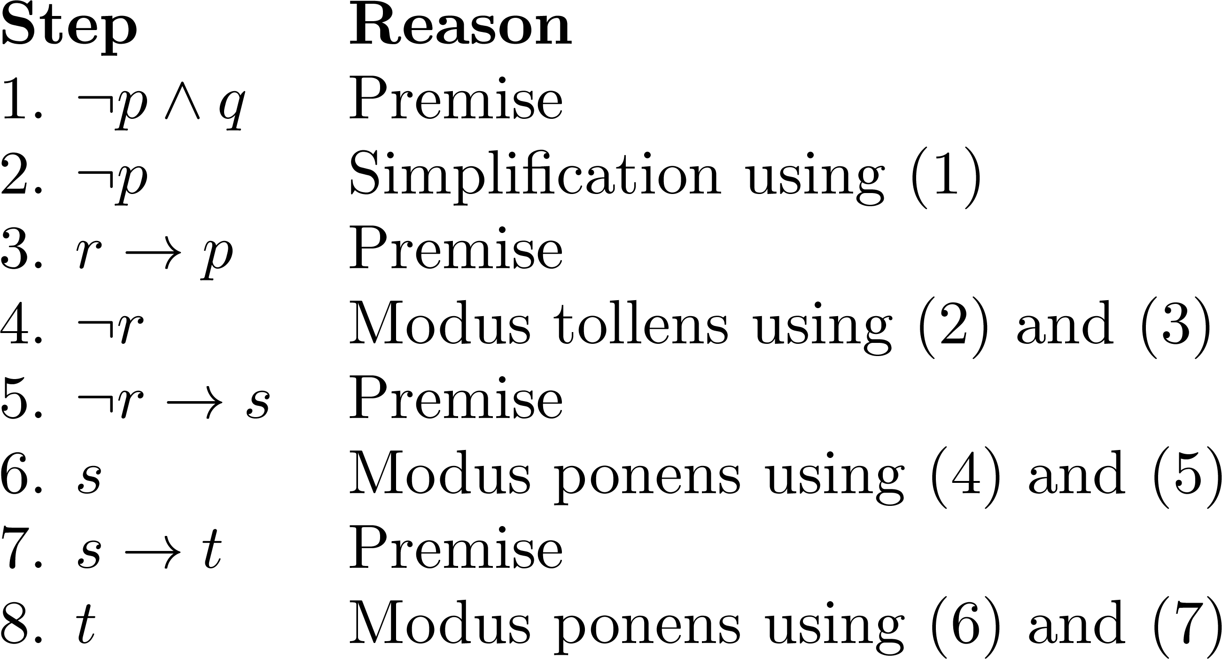
Valid Arguments
This argument form shows that the premises lead to the desired conclusion.
Notes:
Note that a truth table would have 32 rows since we have 5 propositional variables.

Slide 27
Valid Arguments
Example 3:
With these hypotheses:
“If you send me an e-mail message, then I will finish writing the program,” “If you do not send me an e-mail message, then I will go to sleep early,” and “If I go to sleep early, then I will wake up feeling refreshed”
lead to the conclusion:
“If I do not finish writing the program, then I will wake up feeling refreshed.”
Solution:
Choose propositional variables:
p: “You send me an e-mail message,” q: “I will finish writing the program,”
r: “I will go to sleep early,” s: “I will wake up feeling refreshed.
Hypothesis:
p → q, ¬p → r, r → s.
Conclusion:
¬q → s
Continued on next slide →

Slide 28
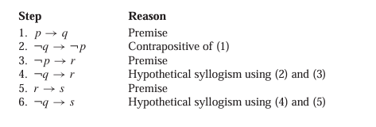
Valid Arguments
This argument form shows that the premises lead to the desired conclusion.

